Slide 1


Towards replicable and generalizable genomic prediction models Oct 12, 2018 NIH intramural presentation
Levi Waldron
City University of New York
Graduate School of Public Health and Health Policy
www.waldronlab.io
@leviwaldron1
Notes:
Cross-study validation (CSV) of prediction models is an alternative to traditional cross-validation (CV) in domains where multiple comparable datasets are available. Although many studies have noted potential sources of heterogeneity in genomic studies, to our knowledge none have systematically investigated their intertwined impacts on prediction accuracy across studies. We employ a hybrid parametric/non-parametric bootstrap method to realistically simulate publicly available compendia of microarray, RNA-seq, and whole metagenome shotgun (WMS) microbiome studies of health outcomes. We assessed CSV accuracy while manipulating the following types of heterogeneity and combinations of them: 1) prevalence of clinical and pathological covariates, 2) differences in predictor covariance as could arise from batch effects, and 3) differences in the ``true'' model predicting outcome. The most easily identifiable sources of study heterogeneity are consistently not the primary ones that undermine the ability to accurately replicate the accuracy of omics prediction models in new studies. Unidentified heterogeneity, such as could arise from unmeasured confounding, may be more important.

Slide 2
Outline
Background
Prognostic models for ovarian cancer
Cross-validation vs. cross-study validation
Why is the accuracy of prediction models that use genomic data often not replicated
Unsupervised classification of CRC transcriptomes
Curating a wealth of data analyst-friendly genomic datasets
Notes:
Abstract: Public databases such as the Gene Expression Omnibus now provide an almost overwhelming free resource for developing and
validating models of association between tumor gene expression and patient outcome in cancer. More than a million gene expression
profiles are available, covering most disease types and study designs. These resources are challenging to utilize due to their unstructured
nature and the potential for unknown sources of heterogeneity between studies. In this talk I will discuss building smaller curated
databases for answering focused research questions, and how experimental and cohort heterogeneity between independent studies can
be identified and leveraged as an advantage for finding robust, generalizable prediction models and biomarkers. I will discuss
"cross-study validation" using all possible combinations of training and validation sets, and show how it can lead to different model
selection and estimations of future prediction performance than traditional cross-validation, and how it can identify outlier studies
and potential sources of heterogeneity.

Slide 3
A note on reproducibility, etc.
 |  | Data
 |  | Same | Different
Code | Same | Reproducible | Replicable
 | Different | Robust | Generalizable
Whitaker, Kirstie (2017): Publishing a reproducible paper.
https://doi.org/10.6084/m9.figshare.4720996.v1

Slide 4
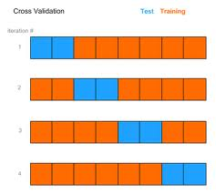
Introduction
Cross-validation etc. are the standard way to
estimate prediction accuracy for the “population” the sample was drawn from
rank supervised learning algorithms
avoid over-optimistic accuracy estimates caused by ‘re-substitution’
Cross-validation
Independent Validation
training test
Dataset 2
Dataset 3

Slide 5
What is the population? Is our sample biased?
Clinical samples use available patients
Are those patients representative of the population of interest?
Do the laboratory procedures introduce bias?
How do these biases impact estimation of prediction accuracy?
Is algorithm performance replicable in new datasets?

Slide 6
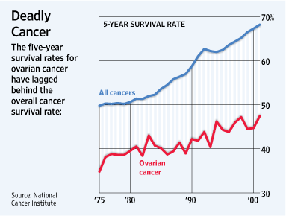
Prognostic gene signatures of ovarian cancer
22,000 new cases each year
14,400 women die each year
Majority late-stage, high-grade, serous carcinoma
Notes:
on ovarian cancer that encompasses all of these. Ovarian cancer is a major cause of mortality, and improvements in prognosis have lagged other cancers. One reason for this is that a majority of patients present with late-stage, high-grade, serous histology – this is a high-risk group with <50% 5-year survival, with little available from a clinical perspective to further refine prognosis.

Slide 7
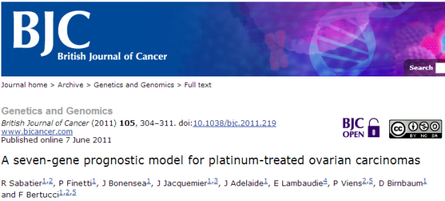
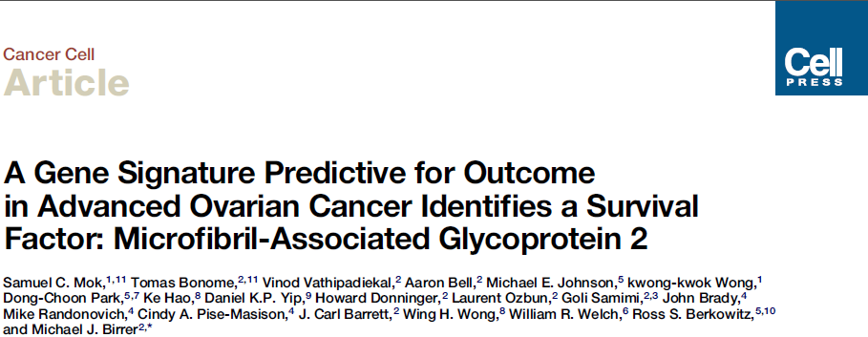
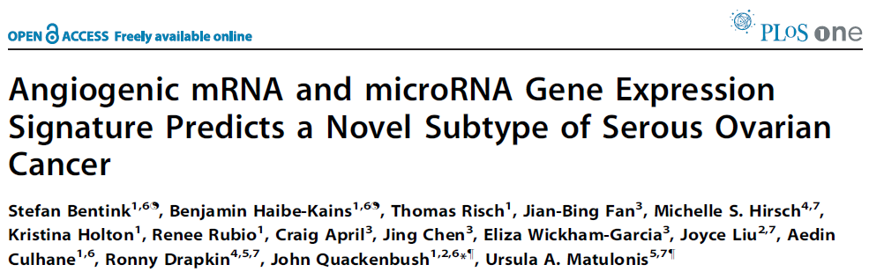
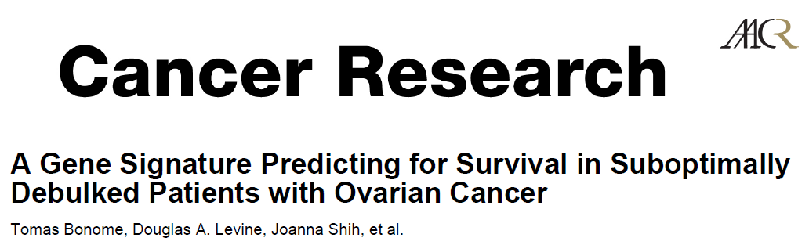
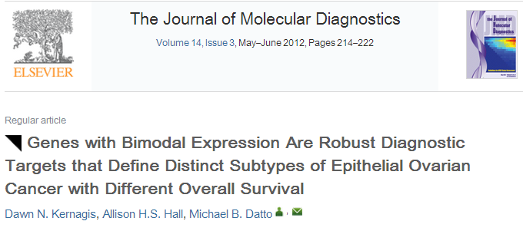
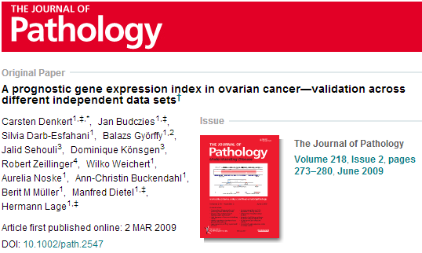

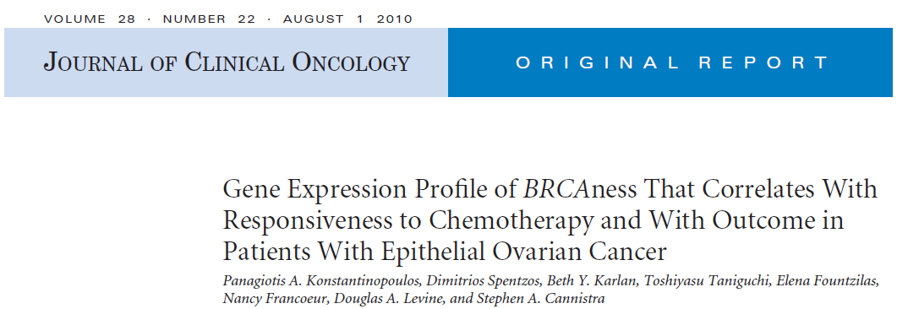
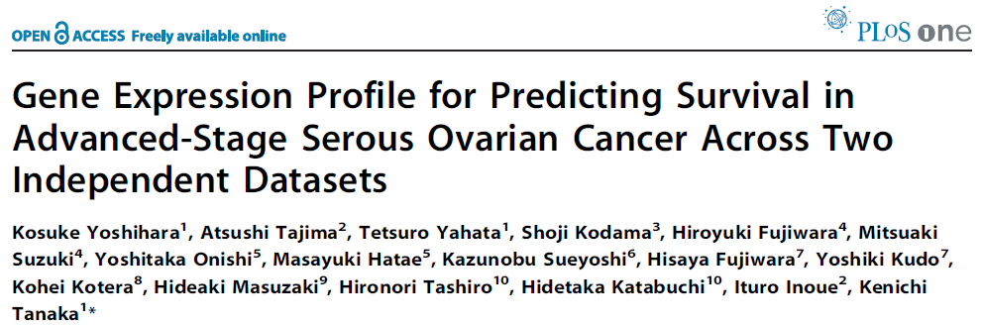
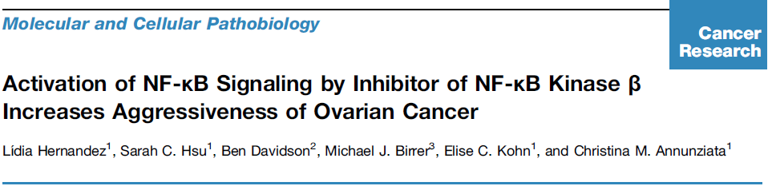



Comparative meta-analysis: prognostic gene signatures of ovarian cancer
Objectives:
Assess the reproducibility of published prognostic gene expression models
Evaluate published models using publicly available data
Improve on models using all publicly available data
With Michael Birrer, MD (UAB)

Slide 8
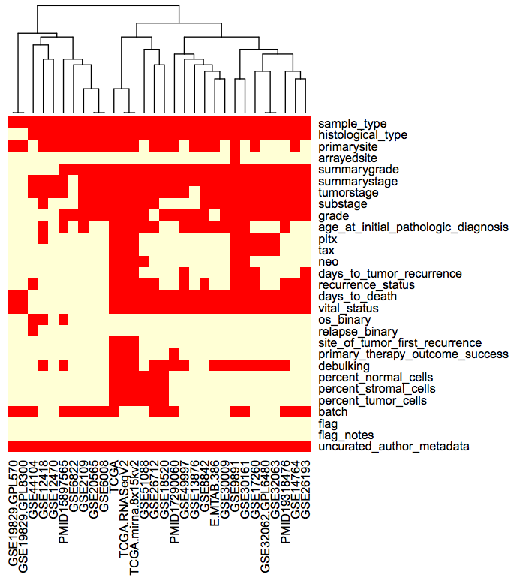
Requirement 1: data curation
curatedOvarianData Bioconductor package
30 datasets, > 3,000 unique samples
B.F. Ganzfried, M. Riester, B. Haibe-Kains, T. Risch, S. Tyekucheva, I. Jazic, X. V. Wang, M. Ahmadifar, M. Birrer, G. Parmigiani, C. Huttenhower, L. Waldron. curatedOvarianData: Clinically Annotated Data for the Ovarian Cancer Transcriptome. DATABASE: the journal of biological databases and curation (2013).

Slide 9
Requirement 2: re-implement published models
Model | Reproducibility
 | Model Provided | Training Data Available | Validation Data Available | Verified Implementation
TCGA11 [12] | YES | YES | YES | YES
Denkert09 [13] | YES | YES | YES | YES
Bonome08_263genes [14] | YES | YES | YES | YES
Bonome08_572genes [14] | YES | YES | YES | YES
Mok09 [15] | NO | YES | YES | PARTIALLY
Yoshihara12 [16] | YES | - | YES | YES
Yoshihara10 [17] | YES | - | YES | YES
Bentink12 [18] | YES | - | YES | YES
Kang12 [19] | YES | YES | YES | PARTIALLY
Crijns09 [20] | NO | YES | NO | NO
Kernagis12 [21] | PARTIALLY | YES | YES | PARTIALLY
Sabatier11 [22] | PARTIALLY | NO | NO | NO
Konstantinopoulos10 [23] | YES | - | YES | PARTIALLY
Hernandez10 [24] | PARTIALLY | - | YES | PARTIALLY
Reproducibility of 14 published models for prognosis of HGSOC
Waldron L et al. JNCI J Natl Cancer Inst 2014;jnci.dju049

Slide 10
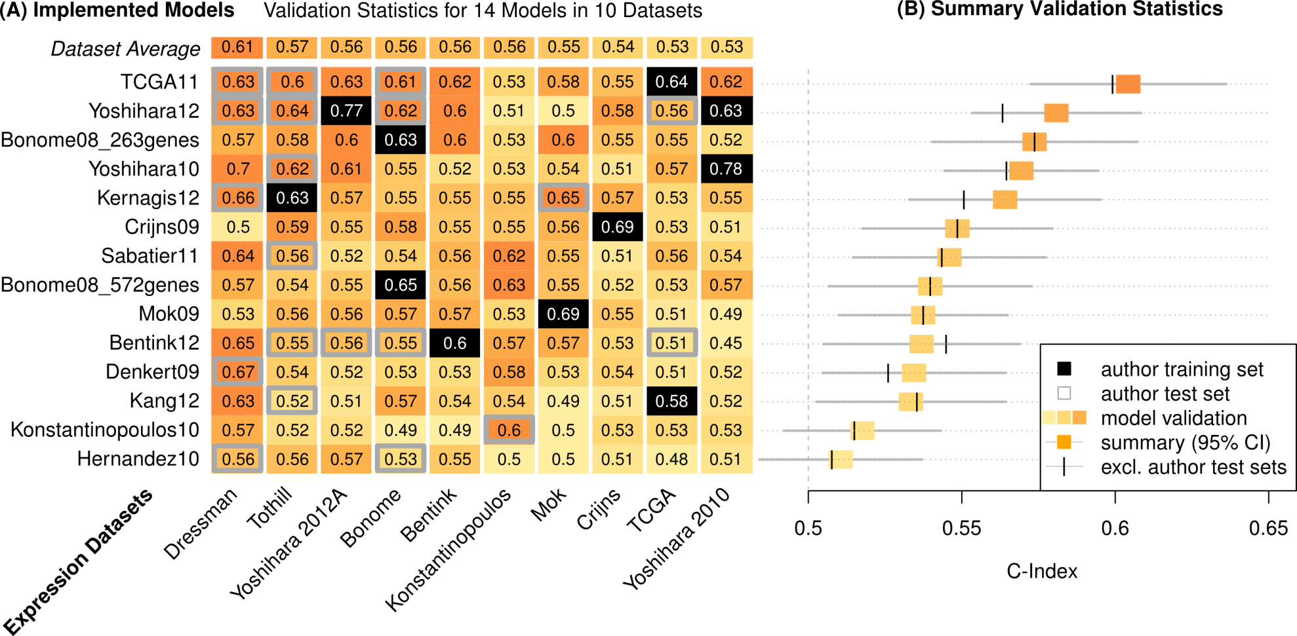
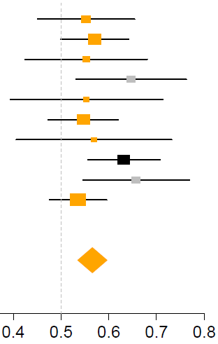
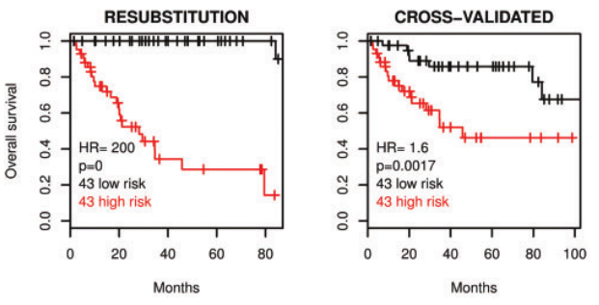
Assessment of prognostic models
Validation Statistics:
14 Models in 10 Datasets
C-Index = Pr(g(Z₁)>g(Z₂) | T₂>T₁)
T₁, T₂ = times to death of two patients
g(Z₁), g(Z₂) = predicted risk scores
C=0.5 expectation for random prediction
C=1 if the exact order of all deaths is predicted
14 prognostic signatures
Forest plot
Kaplan-Meier estimate
Study
Survival
10 microarray datasets
C-Index
Time
Waldron L et al. JNCI J Natl Cancer Inst 2014;jnci.dju049
Notes:
With this groundwork done, the actual analysis was easy by comparison, and the most difficult part was finding ways to visualize so much analyses compactly. This is both a figure and a table, and it summarizes the performance of all major ovarian cancer prognostic signatures published in a 5-year period – it’s a lot take in but we’ll walk through it. First I should explain the C-Index and orange shading – C-Index represents the accuracy of a single model in a single datasets: it’s 0.5 if the predictions are just as good as a coin flip for predicting whether one patient will die before another, and 1 if the model correctly predicts the order in which all deaths occur.
<click> this represents the prediction accuracy of 14 models in each of 10 datasets, and each cell provides the level of information that is represented in a Kaplan-Meier plot, that is, the ability of a model to discriminate patient prognosis in a single dataset. One row represents validation of a single signature on all available studies, or a meta-analysis that would be represented traditionally by a forest plot. The black squares indicate data used to train a model, so you’ll notice their values are higher than other squares. And the grey boxes show datasets used by a signature’s authors for independent validation of that signature, and in theory should be no better or worse than the other validations.
1 or a few squares here encapsulate the findings of most publications. Explain training, author test, independent test sets.

Slide 11
Assessment of prognostic models
Validation Statistics:
14 Models in 10 Datasets
14 prognostic signatures
10 microarray datasets
Waldron L et al. JNCI J Natl Cancer Inst 2014;jnci.dju049
Notes:
We used a standard meta-analysis approach to summarize the performance of each model across all non-training datasets, shown here with 95% confidence intervals. The vertical hashes show how the summary estimate changes if you exclude validation datasets used by the signature’s authors for validation, which is an interesting story that I won’t get into.
Meta-analysis uses a standard fixed-effects model, which is just a weighted average of the C-Index from each study, weighted by the size of the confidence interval in each study. Fixed-effects assumption of homogeneity was not violated.

Slide 12
Assessment of prognostic models
Validation Statistics:
14 Models in 10 Datasets
Dressman et al. J Clin Oncol. 2007 25(5):517-25. An integrated genomic-based approach to individualized treatment of patients with advanced-stage ovarian cancer.
14 prognostic signatures
Baggerly et al. J Clin Oncol. 2008 26(7):1186-7. Run batch effects potentially compromise the usefulness of genomic signatures for ovarian cancer.
Dressman et al. J Clin Oncol. 2012 30(6):678. Retraction.
10 microarray datasets
Waldron L et al. JNCI J Natl Cancer Inst 2014;jnci.dju049
Notes:
This Dressman dataset was published by a group at Duke University, in a paper that claimed to provide a signature of chemosensitivity, which was criticized by Baggerly et al. for batch effects confounded with the outcome. The importance of this confounding was disputed by the authors, but the paper was eventually retracted over issues of reproducing the original findings. This dataset has had an important impact on the ovarian cancer literature, independently of this paper, because it has been very popular as an independent validation dataset for other signatures, as you see can see by the number of grey boxes here. Looking at the average C-Index for this dataset of all signatures, compared to other datasets, it provides consistently higher C-Indices than other datasets, in all likelihood due to its pronounced and confounded batch effect.

Slide 13
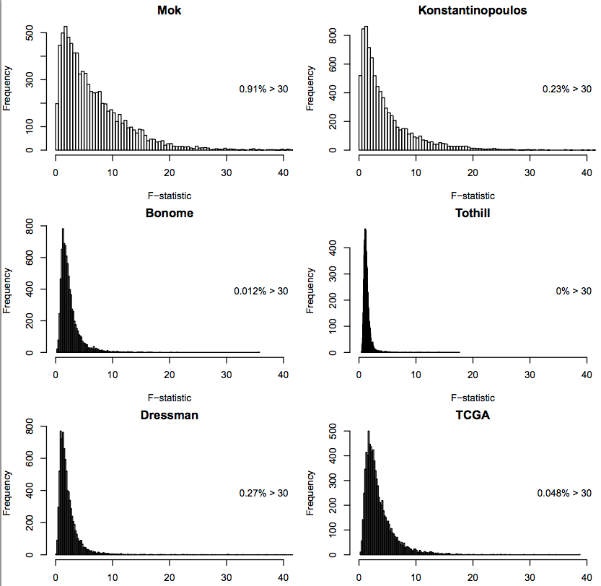
Magnitude of batch effect is not as important as confounding
Histograms shows F-statistic for ANOVA between expression and batch for each gene
The most important batch effects seen were the smallest

Slide 14
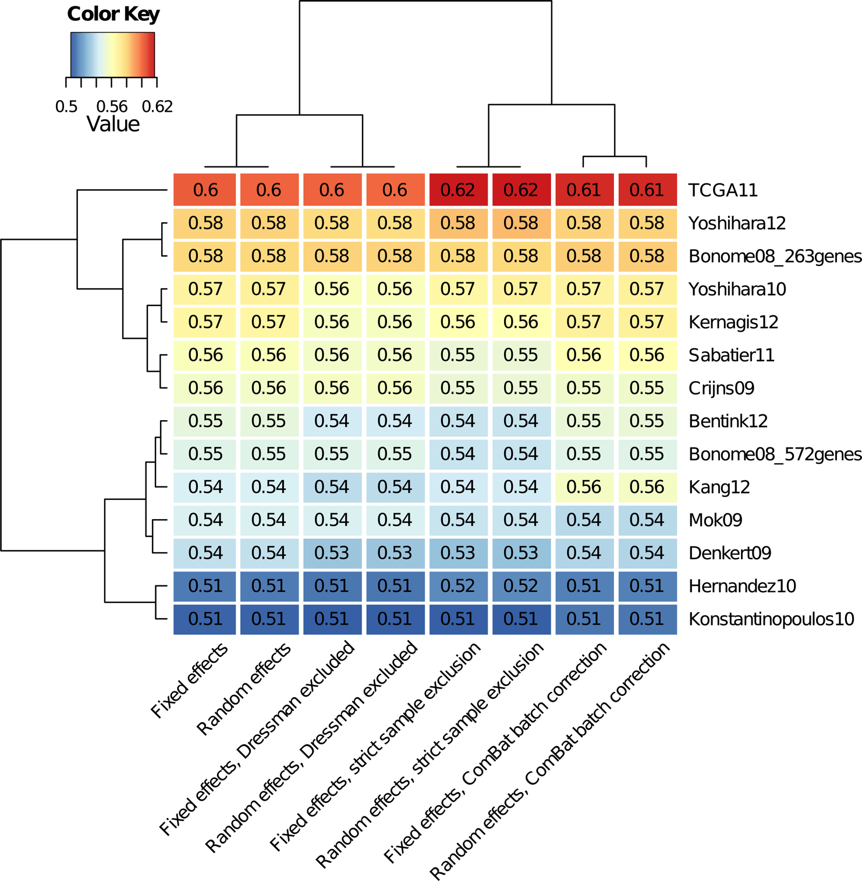
Heterogeneity not a major factor in comparative meta-analysis
Waldron L et al. JNCI J Natl Cancer Inst 2014;jnci.dju049

Slide 15
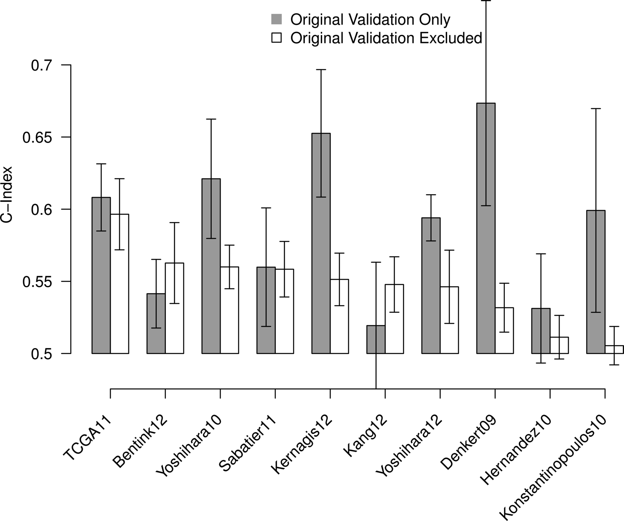
Influence of validation set choice
Waldron L et al. JNCI J Natl Cancer Inst 2014;jnci.dju049

Slide 16
Assessment of gene signatures (not models)
Start with a signature defined as a list of genes
Fit a simple prediction algorithm (β = ±1)
Compute “leave-one-in” matrix of C-statistics
Repeat with random gene sets
Dataset #
 | 1 | 2 | 3 | 4 | 5
1 | TRAIN | TEST | TEST | TEST | TEST
2 | TEST | TRAIN | TEST | TEST | TEST
3 | TEST | TEST | TRAIN | TEST | TEST
4 | TEST | TEST | TEST | TRAIN | TEST
5 | TEST | TEST | TEST | TEST | TRAIN
Iteration #
“Z-matrix”
Notes:
We were interested not just in assessing fully-specified prediction algorithms, but the genes used by those algorithms. Sometimes all we care about are the predictions, but often, a lot of effort goes into thinking hard about those genes and coming up with a biological explanation of why they work so well in this prediction algorithm. But the fact is, there are situations where you can make OK predictions from random gene sets, so the objective here was to use all the datasets for independent validation and assess these gene signatures. So the procedure was:
Summarize prognostic quality of a gene list by its average C-statistic for off-diagonal elements in this matrix of validation statistics

Slide 17
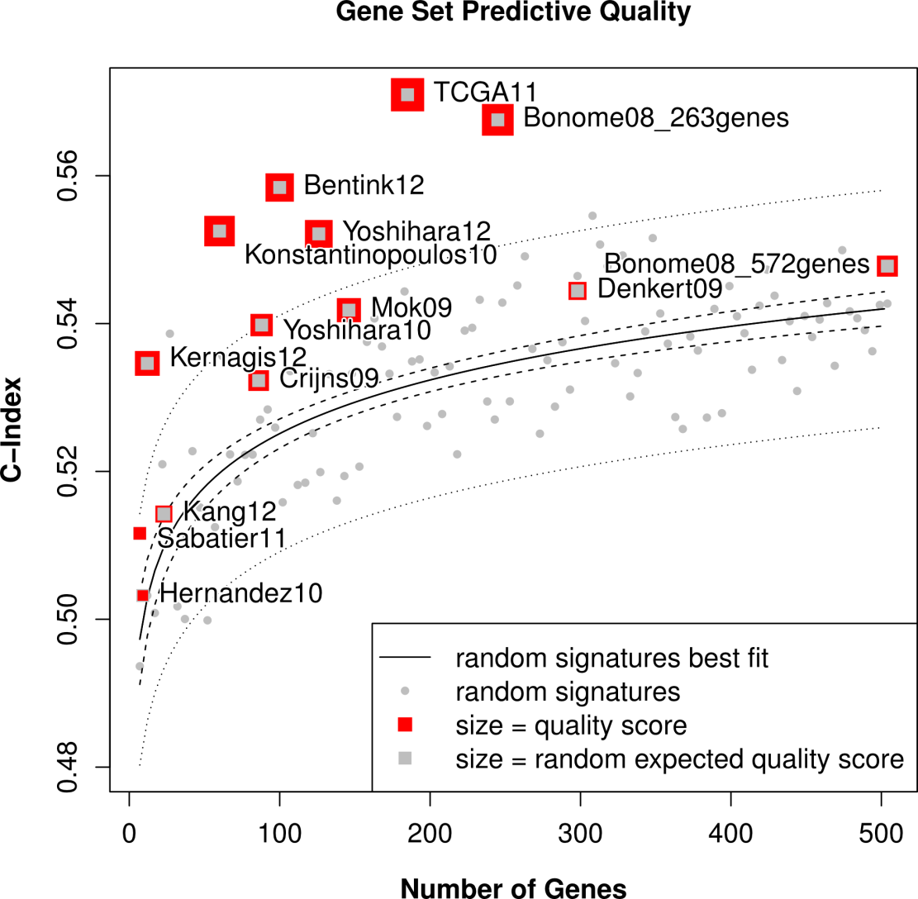
Assessment of gene signatures
About half of gene signatures provide prognostic “value added” over 97.5% of gene random signatures
Waldron L et al. JNCI J Natl Cancer Inst 2014;jnci.dju049
Notes:
What I show here is the mean C-statistic across all combinations of training and independent validation sets, as a function of the number of genes in the signature.

Slide 18
Simulating realistic ensembles of independent datasets
Fit a “true model” to each of i=1, …, I datasets, including clinical covariates
For b= 1, ... ,B= 1000 iterations:
re-sample I datasets with replacement
re-sample N patients with replacement from each
simulate outcome labels from “true model”
Bernau, C. et al. Cross-study validation for the assessment of prediction algorithms.
Bioinformatics 30, i105–i112 (2014).
https://www.bioconductor.org/packages/simulatorZ/ - Maintainer: Yuqing Zhang

Slide 19
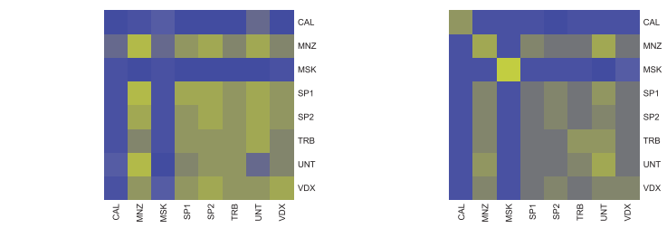
Hybrid parametric / non-parametric bootstrap procedure
Experimental data
Simulated data
8 independent
breast cancer
studies
“Z-matrix”
Bernau, C. et al. Cross-study validation for the assessment of prediction algorithms.
Bioinformatics 30, i105–i112 (2014).
https://www.bioconductor.org/packages/simulatorZ/ - Maintainer: Yuqing Zhang

Slide 20
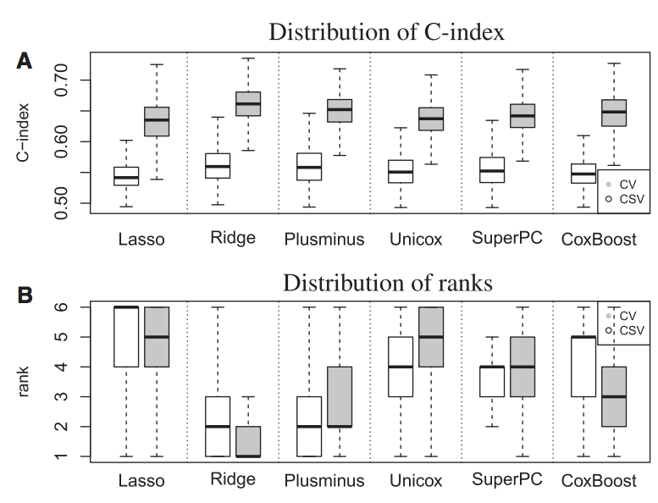
CSV compared to CV in breast cancer
1000 simulations of 8 datasets
median CV, CSV
Specialists?
Generalists?
Bernau, C. et al. Cross-study validation for the assessment of prediction algorithms.
Bioinformatics 30, i105–i112 (2014).
Notes:
Lasso, Ridge, Coxboost have specialist tendencies

Slide 21
What causes loss of prediction accuracy?
Many studies have noted potential sources of heterogeneity in genomic studies
None have systematically investigated their impacts on prediction accuracy across studies
Zhang Y et al. The impact of different sources of heterogeneity on loss of accuracy from genomic prediction models. Biostatistics kxy044 (2018).

Slide 22
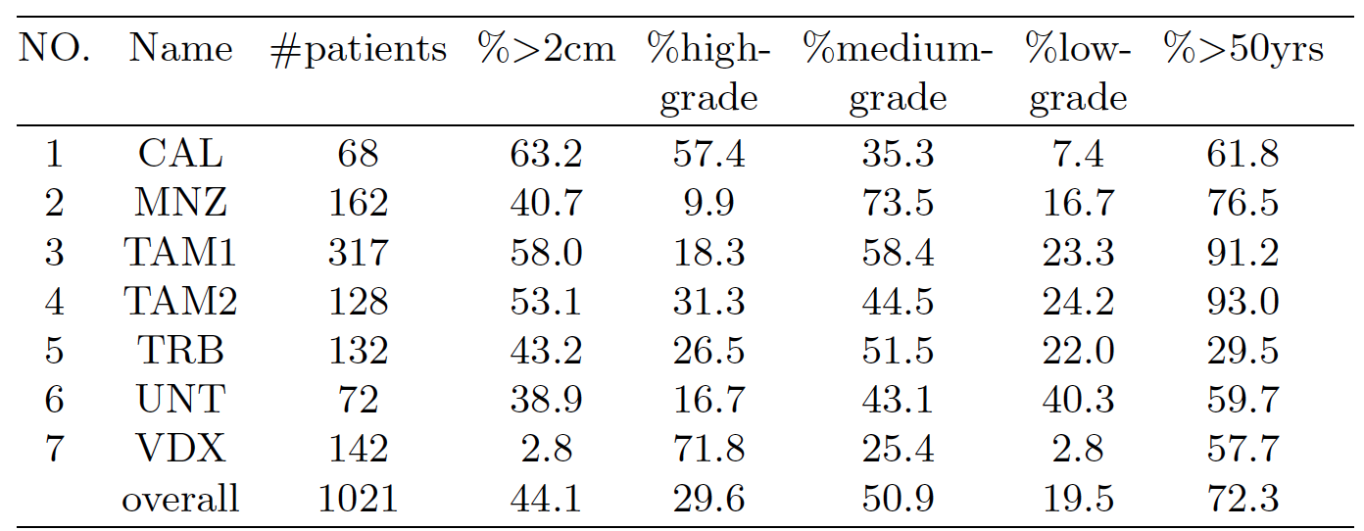
What causes loss of prediction accuracy?
Three types of heterogeneity between studies are manipulated and studied:
imbalances in the prevalence of clinical and pathological covariates
Manipulate re-sampling probabilities to produce identical joint probability distributions of clinical covariates across datasets
Zhang Y et al. The impact of different sources of heterogeneity on loss of accuracy from genomic prediction models. Biostatistics kxy044 (2018).

Slide 23
What kinds of heterogeneity cause loss of accuracy?
Three types of heterogeneity between studies are manipulated and studied:
differences in gene covariance due to batch, platform, or tumor purity effects
Filter genes with low Integrative Correlation
Zhang Y et al. The impact of different sources of heterogeneity on loss of accuracy from genomic prediction models. Biostatistics kxy044 (2018).

Slide 24
What kinds of heterogeneity cause loss of accuracy?
Three types of heterogeneity between studies are manipulated and studied:
residual confounding or other reasons for different “true" models between gene expression / clinical factors and outcome.
Equalize baseline hazards
Use identical generative models for every dataset
Zhang Y et al. The impact of different sources of heterogeneity on loss of accuracy from genomic prediction models. Biostatistics kxy044 (2018).

Slide 25
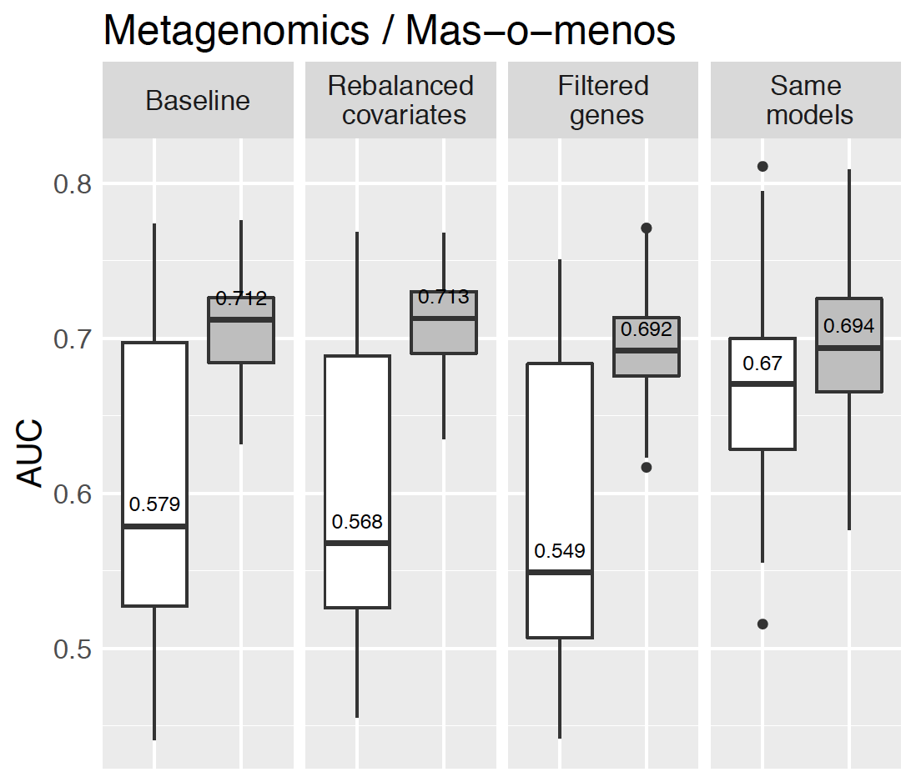
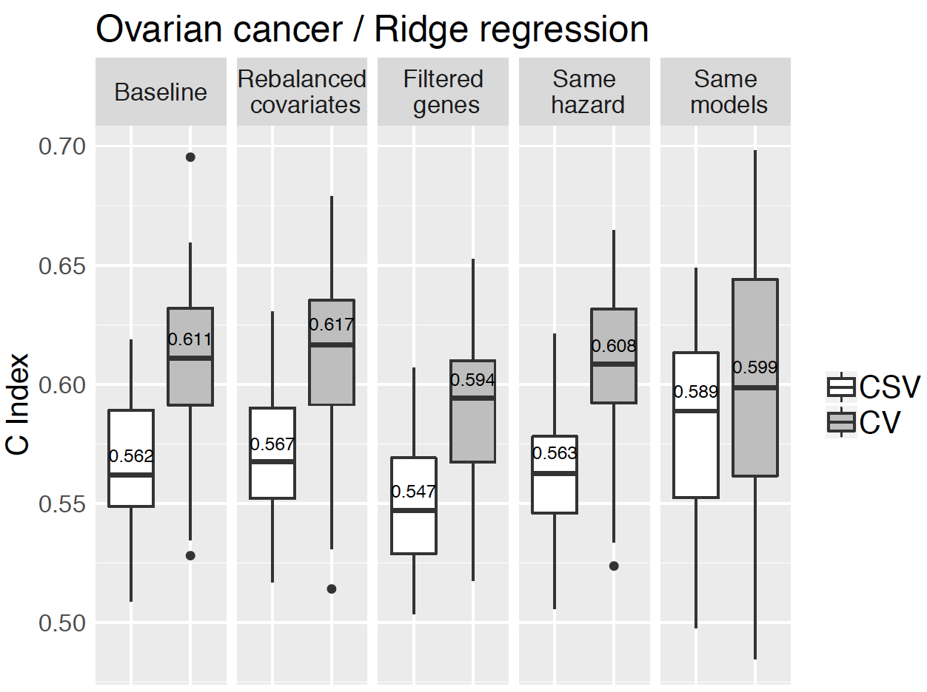
What causes degradation in CSV?
Platforms: RNA-seq, microarray, metagenomics
Outcomes: binary, time-to-event
Diseases: breast cancer, ovarian cancer, type 2 diabetes
Zhang Y et al. The impact of different sources of heterogeneity on loss of accuracy from genomic prediction models. Biostatistics kxy044 (2018).

Slide 26
Summary: sources of heterogeneity
Easily identifiable sources of heterogeneity are not necessarily the most important ones
Unidentified heterogeneity, such as from unmeasured confounding, may be more important
Zhang Y et al. The impact of different sources of heterogeneity on loss of accuracy from genomic prediction models. Biostatistics kxy044 (2018).

Slide 27
Unsupervised classification of CRC transcriptomes
Numerous efforts have defined discrete transcriptome subtypes of CRC
Consolidated as 4 subtypes by Guinney et al. (Nat. Med. 2015) who proposed “consensus molecular subtypes”
Appealing relationships to MSI, immune activation, WNT/MYC activation…
Guinney J et al.: The consensus molecular subtypes of colorectal cancer. Nat. Med. 2015, 21:1350–1356.
Ma S et al.: Continuity of transcriptomes among colorectal cancer subtypes based on meta-analysis. Genome Biol. 2018, 19:142.

Slide 28
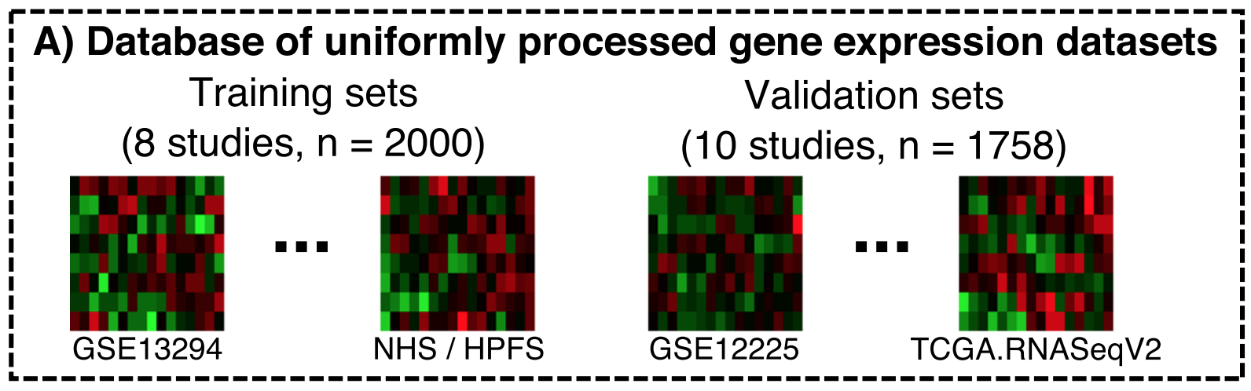
CRC transcriptome subtype discovery and validation by meta-analysis
microarray FFPE array microarray RNA-seq
Ma S, Ogino S, Parsana P, Nishihara R, Qian Z, Shen J, Mima K, Masugi Y, Cao Y, Nowak JA, Shima K, Hoshida Y, Giovannucci EL, Gala MK, Chan AT, Fuchs CS, Parmigiani G, Huttenhower C, Waldron L: Continuity of transcriptomes among colorectal cancer subtypes based on meta-analysis. Genome Biol. 2018, 19:142.

Slide 29
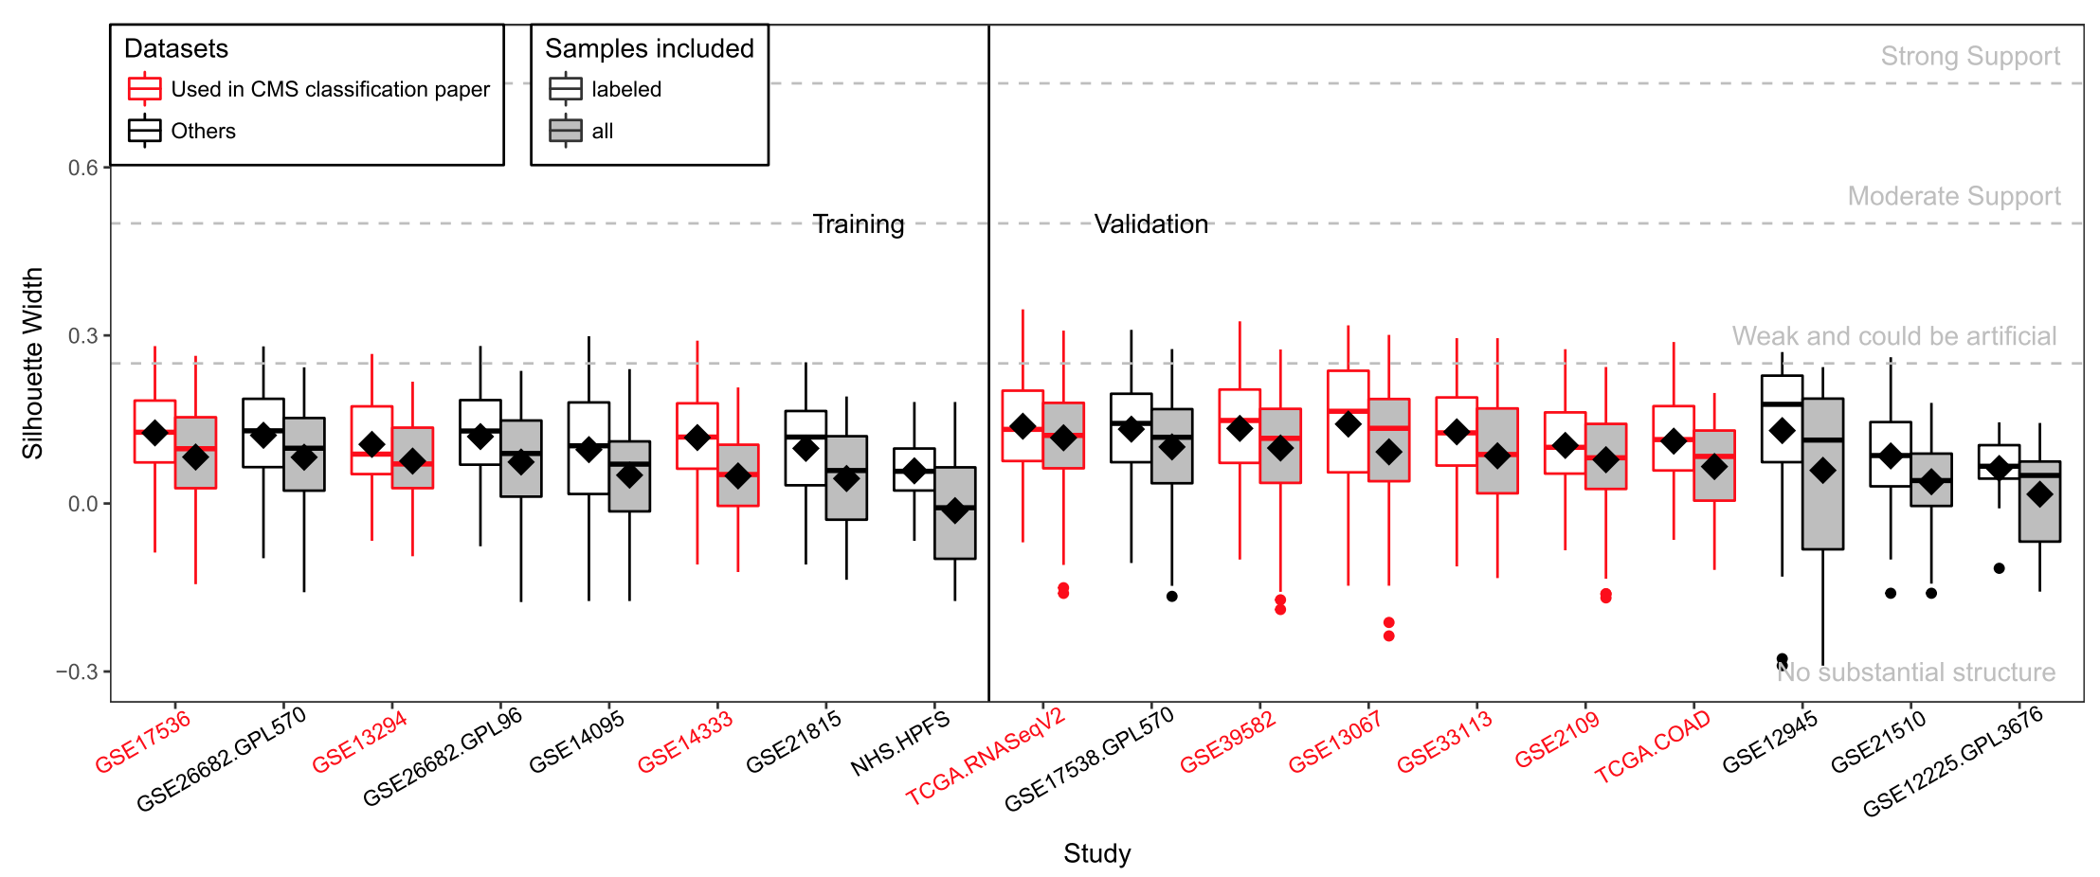
Evaluating discreteness of published CRC subtypes
Guinney J et al.: The consensus molecular subtypes of colorectal cancer. Nat. Med. 2015, 21:1350–1356.
Strong Support
Moderate Support
Weak and could be artificial
Silhouette Width
No substantial structure
Dataset
Weak evidence of subtypes across many datasets

Slide 30
Weak evidence for discrete molecular subtypes
Using multiple measures of cluster discreteness and robustness
In a stroma-free xenograft dataset
For a classifier developed from xenograft
For classifiers re-trained by other methods
Not the same as “proving there are no subtypes”
Yamauchi M, Morikawa T, Kuchiba A, Imamura Y, Qian ZR, Nishihara R, Liao X, Waldron L, Hoshida Y, Huttenhower C, Chan AT, Giovannucci E, Fuchs C, Ogino S: Assessment of colorectal cancer molecular features along bowel subsites challenges the conception of distinct dichotomy of proximal versus distal colorectum. Gut 2012, 61:847–854.

Slide 31
Discovery of better supported continuous CRC “subtypes”
Objectives:
Use numerous publicly available expression datasets to discover discrete or continuous subtypes
Be robust to batch, platform, and study effects
Provide a well-validated summary descriptor of the CRC transcriptome
Ma S, Ogino S, Parsana P, Nishihara R, Qian Z, Shen J, Mima K, Masugi Y, Cao Y, Nowak JA, Shima K, Hoshida Y, Giovannucci EL, Gala MK, Chan AT, Fuchs CS, Parmigiani G, Huttenhower C, Waldron L: Continuity of transcriptomes among colorectal cancer subtypes based on meta-analysis. Genome Biol. 2018, 19:142.

Slide 32
Discovery of better supported continuous CRC “subtypes”
Methods:
Per-dataset Principal Components Analysis
Network analysis of loadings
Identification of connected components
Different performance than e.g. Canonical Correlation Analysis (CCA):
No requirement for independence
Unaffected by major batch effects
Unaffected by nonsense datasets & samples

Slide 33
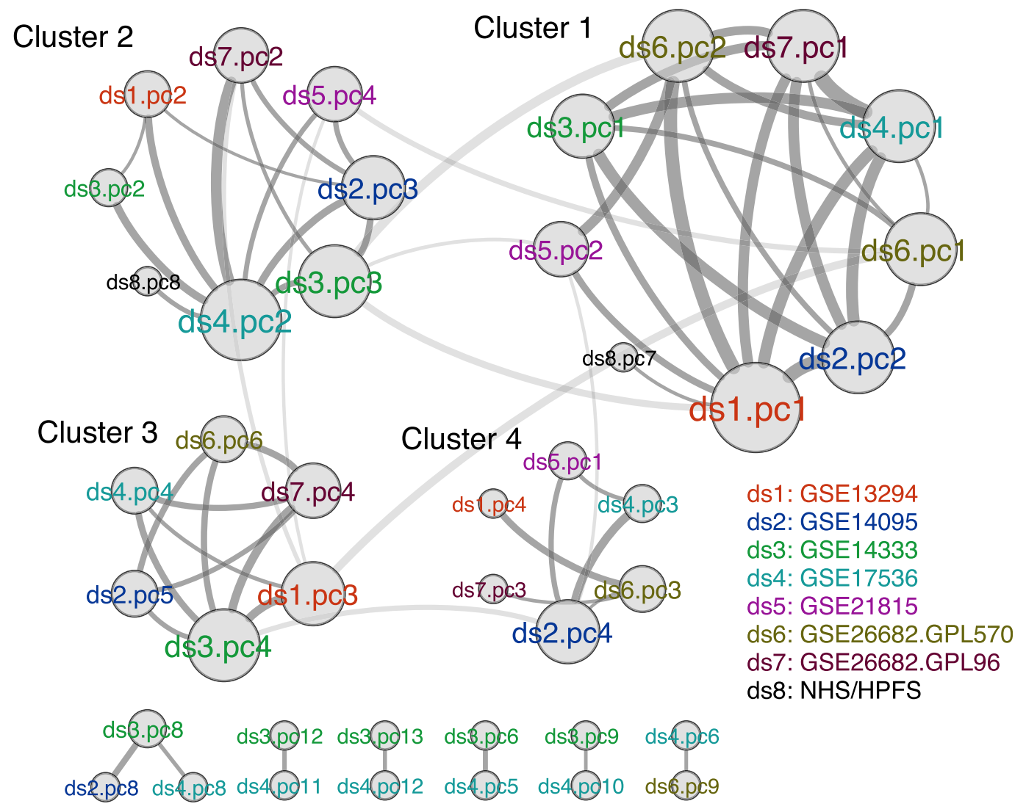
Discovery of better supported continuous CRC “subtypes”
Mean loadings
define subtype “scores”
Score = weighted avg of expression values
FFPE tissues
Illumina “DASL” array

Slide 34
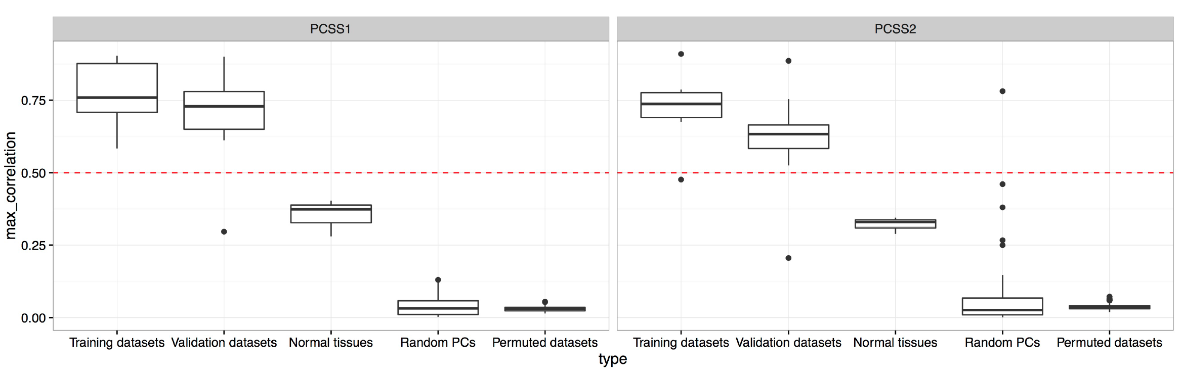
Validation of Principal Component Subtype Scores (PCSS1 and PCSS2)
Max{ cor(PCSS, PC_{j}) } j=1…8
Each point is a dataset

Slide 35
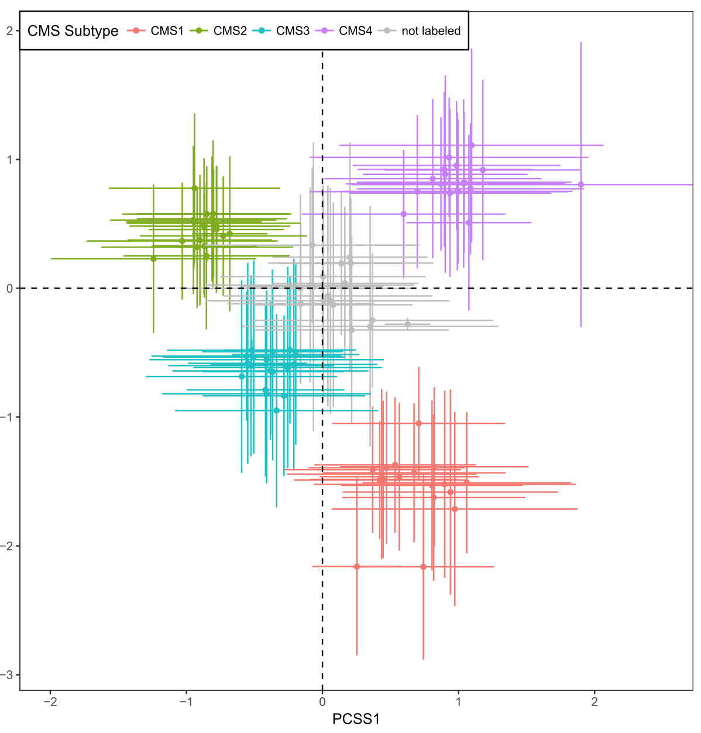
Principal Component Subtype Scores are consistent with previous subtypes
CMS4
CMS2
Unlabeled
by CMS
PCSS2
Each cross
=
one dataset
CMS3
CMS1
PCSS1

Slide 36
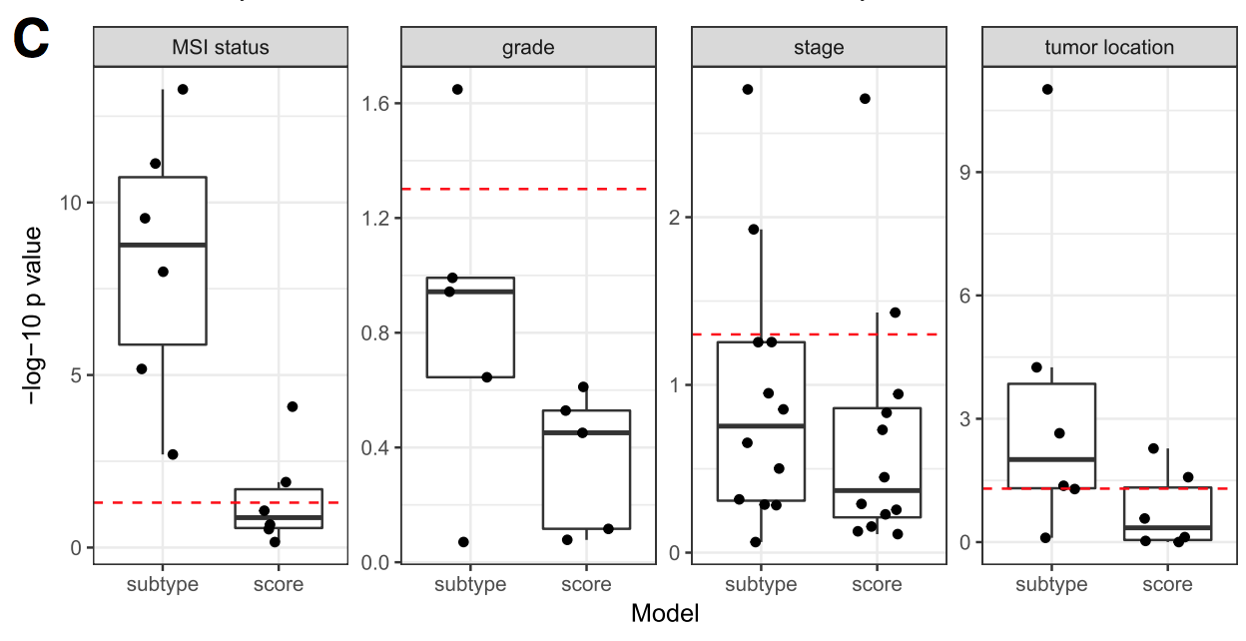
PCSS are more correlated with clinicopathological variables
Likelihood Ratio Test for y ~ CMS + PCSS vs:
~ CMS only
~ PCSS only

Slide 37
Summary: CRC molecular subtypes
An assumption of discrete transcriptome subtypes of CRC has persisted despite a lack of evidence for them
Novel method identifies robust, validated “principal component subtype scores”
Ma S, Ogino S, Parsana P, Nishihara R, Qian Z, Shen J, Mima K, Masugi Y, Cao Y, Nowak JA, Shima K, Hoshida Y, Giovannucci EL, Gala MK, Chan AT, Fuchs CS, Parmigiani G, Huttenhower C, Waldron L: Continuity of transcriptomes among colorectal cancer subtypes based on meta-analysis. Genome Biol. 2018, 19:142.

Slide 38
High-grade serous ovarian carcinoma an alternative approach
Improving unsupervised classifier performance by:
Refusing to classify increasing numbers of ambiguous tumors
Training on unambiguous “consensus” tumors
Chen GM, Kannan L, Geistlinger L, Kofia V, Safikhani Z, Gendoo DMA, Parmigiani G, Birrer M, Haibe-Kains B, Waldron L: Consensus on Molecular Subtypes of High-Grade Serous Ovarian Carcinoma. Clin. Cancer Res. 2018:clincanres.0784.2018.

Slide 39
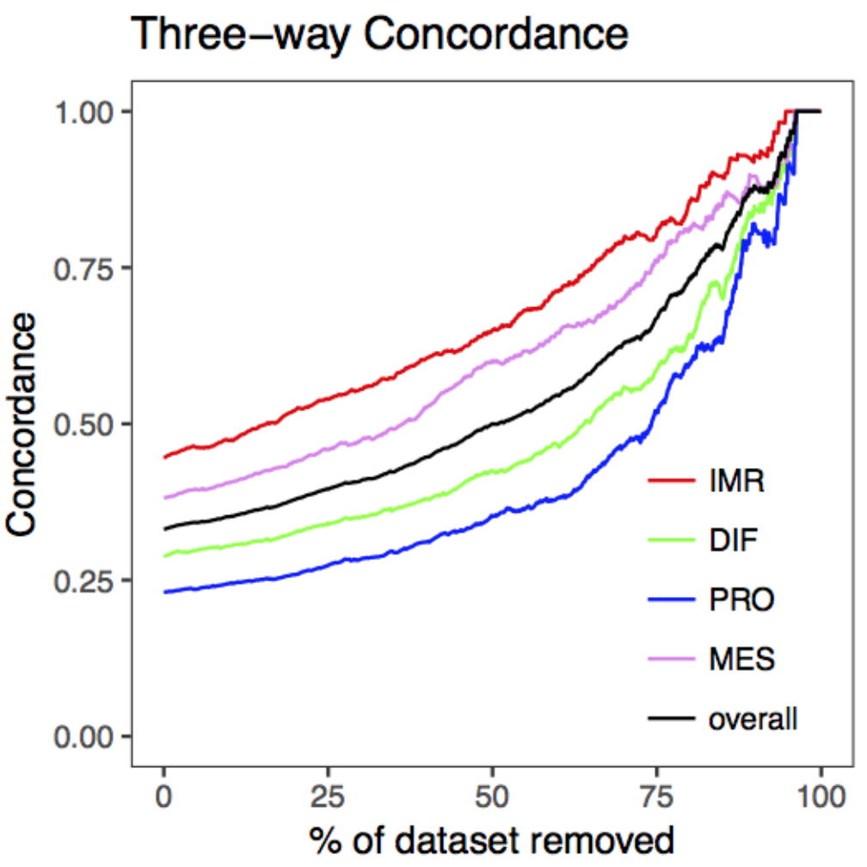
Concordance between classifiers of high-grade serous ovarian carcinoma
Tumors confidently called by all three classifiers.
High concordance for <25% of tumors
All tumors
Low replicability between classifiers of different groups
Konecny et al.: Prognostic and therapeutic relevance of molecular subtypes in high-grade serous ovarian cancer. J. Natl. Cancer Inst. 2014, 106.
Verhaak et al.: Prognostically relevant gene signatures of high-grade serous ovarian carcinoma. J. Clin. Invest. 2012, 123:517–525.
Tothill: Novel molecular subtypes of serous and endometrioid ovarian cancer linked to clinical outcome. Clin. Cancer Res. 2008, 14:5198–5208.

Slide 40
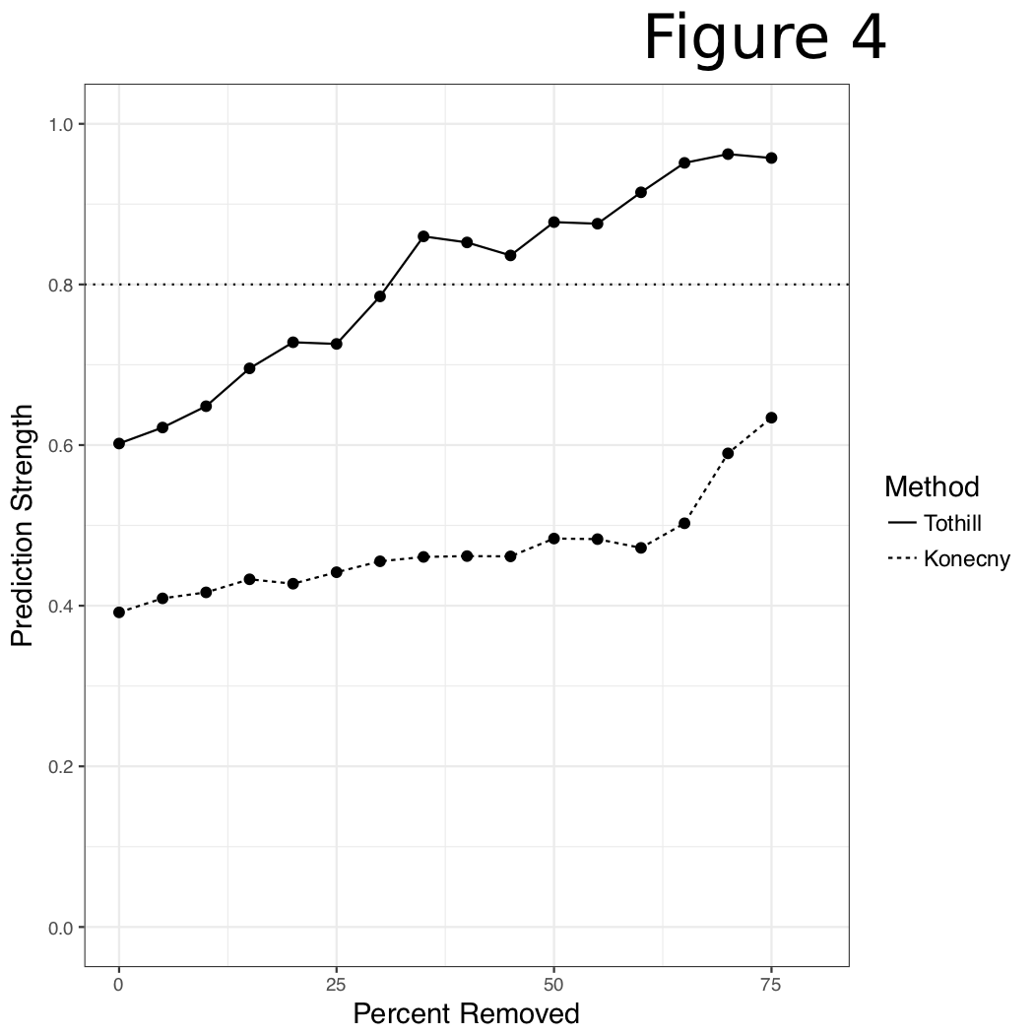
Robustness improves with refusing to classify more tumors
Decent robustness and discreteness for ~25% of tumors
Bioconductor package:
consensusOV

Slide 41
Creating a wealth of curated, analyst-friendly datasets
curatedOvarianData
30 datasets, most annotated for OS, surgical debulking, histology
curatedCRCData
34 datasets, many annotated for MSS, gender, stage, age, N, M
curatedBladderData
12 datasets, many annotated for stage, grade, OS
curatedTCGAData
The Cancer Genome Atlas as MultiAssayExperiment
cBioPortalData (still GitHub.com/waldronlab only)
>150 multi’omics cancer datasets as MultiAssayExperiment
HMP16SData
Painless access to The Human Microbiome Project
curatedMetagenomicData
>30 datasets of microbiome abundance and metabolic function
most annotated for age, BMI, sex, disease
Includes the Human Microbiome Project

Slide 42
The need for MultiAssayExperiment
Need a core Bioconductor data structure to:
harmonize single-assay data structures
relate multiple assays with one set of clinical data
handle missing and replicate observations
accommodate ID-based and range-based data
support on-disk representations of big data
Ramos M, Schiffer L, Re A, Azhar R, Basunia A, Rodriguez C, Chan T, Chapman P, Davis SR, Gomez-Cabrero D, Culhane AC, Haibe-Kains B, Hansen KD, Kodali H, Louis MS, Mer AS, Riester M, Morgan M, Carey V, Waldron L: Software for the Integration of Multiomics Experiments in Bioconductor. Cancer Res. 2017, 77:e39–e42.
Notes:
A core data structure was needed to
* harmonize existing structures for different types of data,
* relate assays with each other and clinical data
* handle the reality that such experiments are often incomplete and missing observations on some assays, and also may contain replicates, time series, or matched normal,
* accommodate data that are indexed by IDs such as genes and data indexed by genomic ranges,
* and support on-disk representations for big data

Slide 43
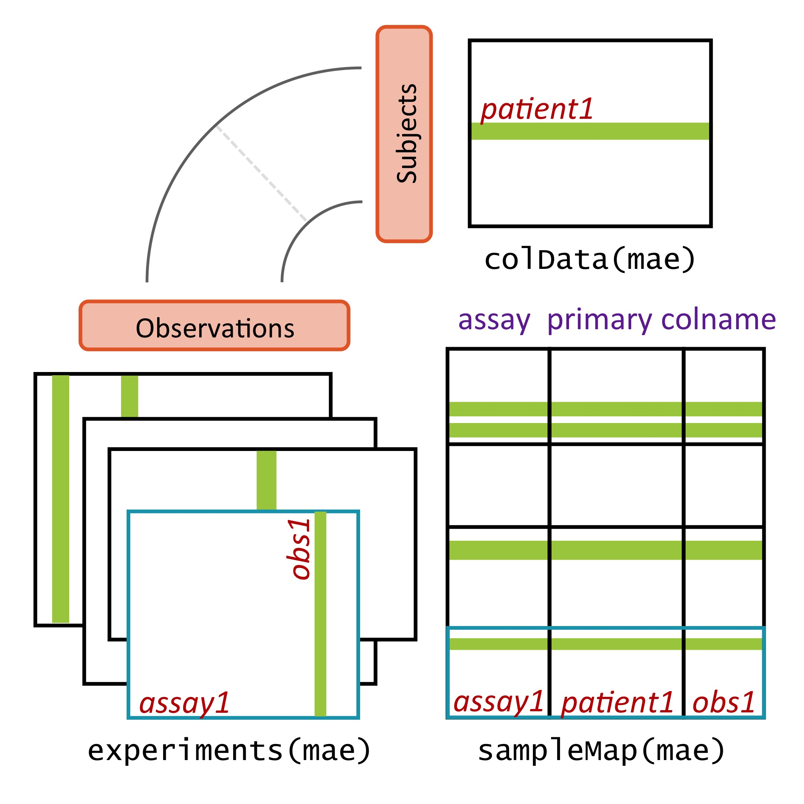
MultiAssayExperiment design
Figure Credit: Marcel Ramos
Ramos M et al.: Software for the Integration of Multiomics Experiments in Bioconductor. Cancer Res. 2017, 77:e39–e42.
Notes:
MultiAssayExperiment addresses these challenges by relating a table of information about subjects, say clinical and pathological data, to a series of genomic data sets of arbitrary shape and even non-tabular data, via a map or a network relating these. This sounds complex and it can be, but from the analyst’s perspective, there is an API that will be familiar to users of R, and that abstracts this complexity from the user. Constructing, accessing, subsetting, data management or manipulation, and combining and reshaping into forms usable by standard tools become straightforward.

Slide 44
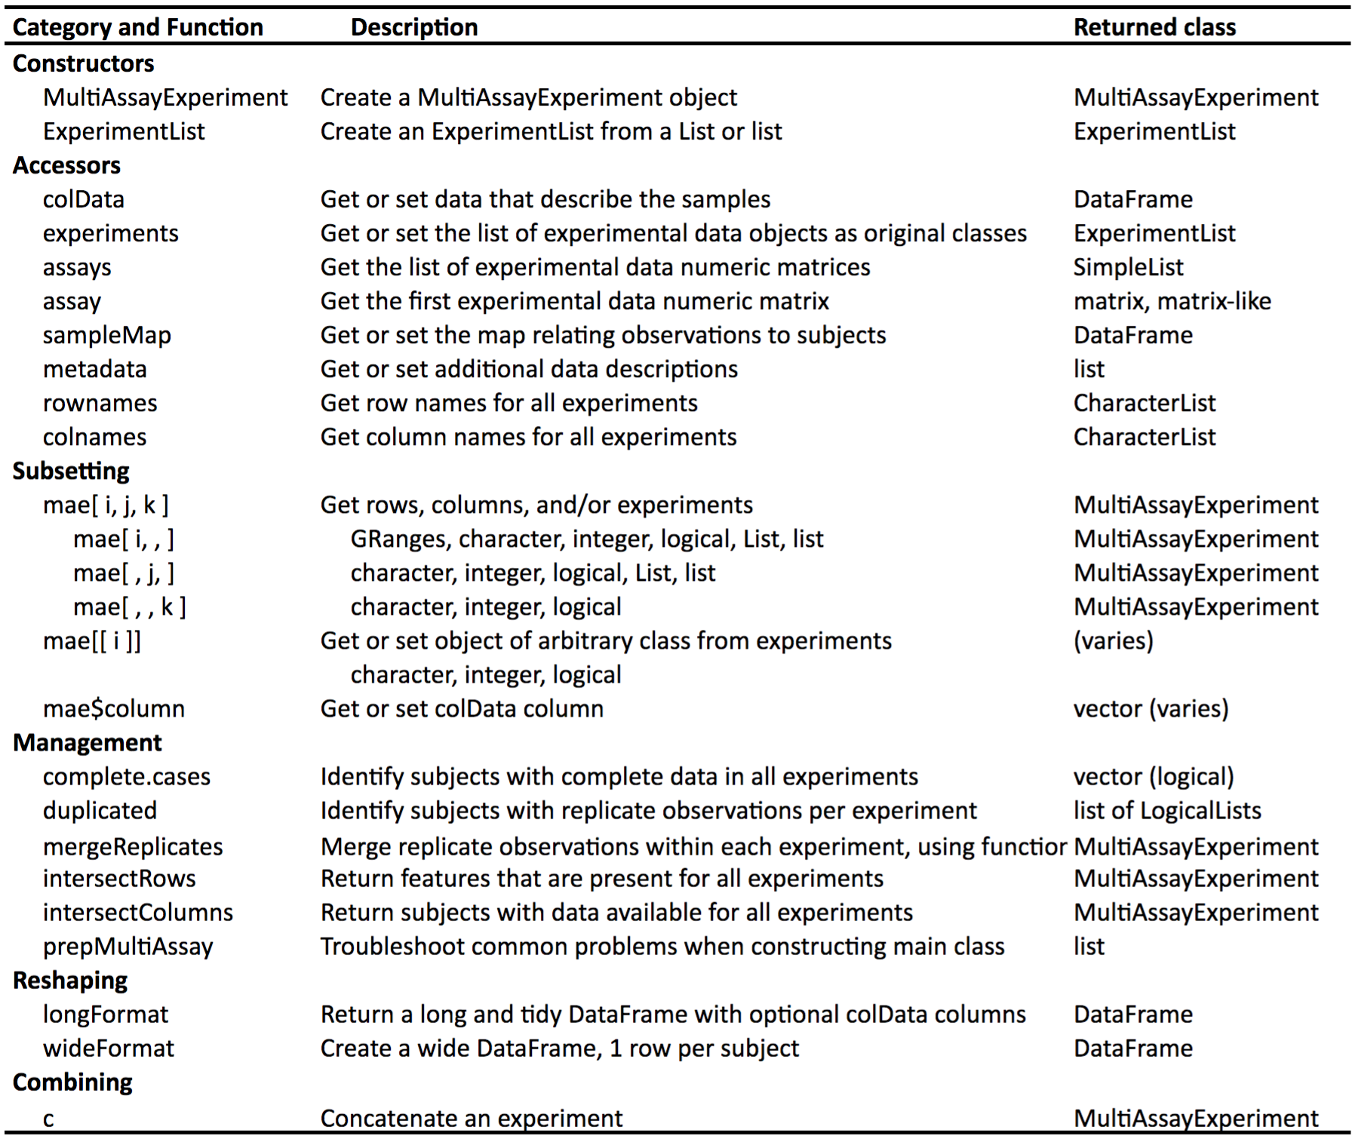
The MultiAssayExperiment API
Notes:
To help those wanting to analyze TCGA data, we’ve constructed MultiAssayExperiments for 33 cancer types. Each cancer type is represented by a single object containing all the most commonly used, unrestricted data. These objects are immediately usable, even on most laptops, with the API shown on the previous page.

Slide 45
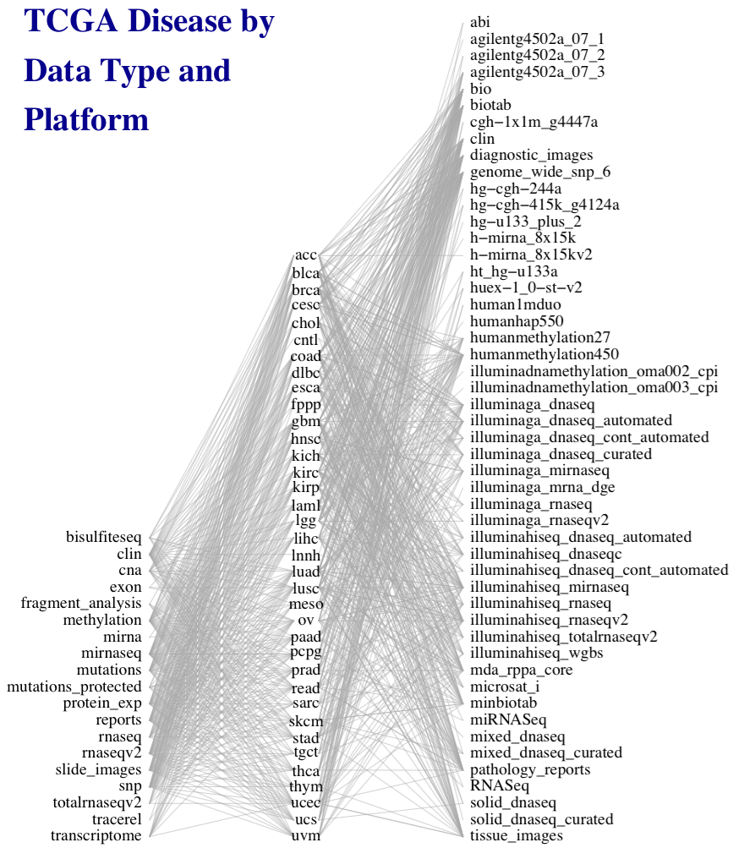
Managing complex data
50 platforms
Integrative Representation and Analysis of Complex Cancer Data Sets
33 diseases
e.g. TCGA
19 data types
Figure credit: Marcel Ramos
Ramos M et al.: Software for the Integration of Multiomics Experiments in Bioconductor. Cancer Res. 2017, 77:e39–e42.
Notes:
This work was motivated by the need to simplify general statistical analysis and development of bioinformatic tools for a study as complex as the Cancer Genome Atlas, where 33 cancers were assayed on many platforms to generate different types of data, but also to provide a simplified framework for more easily reproducible and less error-prone analysis of simpler experiments involving just a couple of complementary assays and clinical data.

Slide 46
curatedTCGAData
> acc <- curatedTCGAData(diseaseCode = "ACC", assays="*", dry.run = FALSE)
> acc
A MultiAssayExperiment object of 9 listed
experiments with user-defined names and respective classes.
Containing an ExperimentList class object of length 9:
[1] ACC_CNASNP-20160128: RaggedExperiment with 79861 rows and 180 columns
[2] ACC_CNVSNP-20160128: RaggedExperiment with 21052 rows and 180 columns
[3] ACC_GISTIC_AllByGene-20160128: SummarizedExperiment with 24776 rows and 90 columns
[4] ACC_GISTIC_ThresholdedByGene-20160128: SummarizedExperiment with 24776 rows and 90 columns
[5] ACC_Methylation-20160128: SummarizedExperiment with 485577 rows and 80 columns
[6] ACC_miRNASeqGene-20160128: SummarizedExperiment with 1046 rows and 80 columns
[7] ACC_Mutation-20160128: RaggedExperiment with 20166 rows and 90 columns
[8] ACC_RNASeq2GeneNorm-20160128: SummarizedExperiment with 20501 rows and 79 columns
[9] ACC_RPPAArray-20160128: SummarizedExperiment with 192 rows and 46 columns
Features:
experiments() - obtain the ExperimentList instance
colData() - the primary/phenotype DataFrame
sampleMap() - the sample availability DataFrame
`$`, `[`, `[[` - extract colData columns, subset, or experiment
*Format() - convert into a long or wide DataFrame
assays() - convert ExperimentList to a SimpleList of matrices
>
Ramos et al. Software for the Integration of Multi-omics Experiments in Bioconductor. Cancer Research 2017, 77(21).

Slide 47
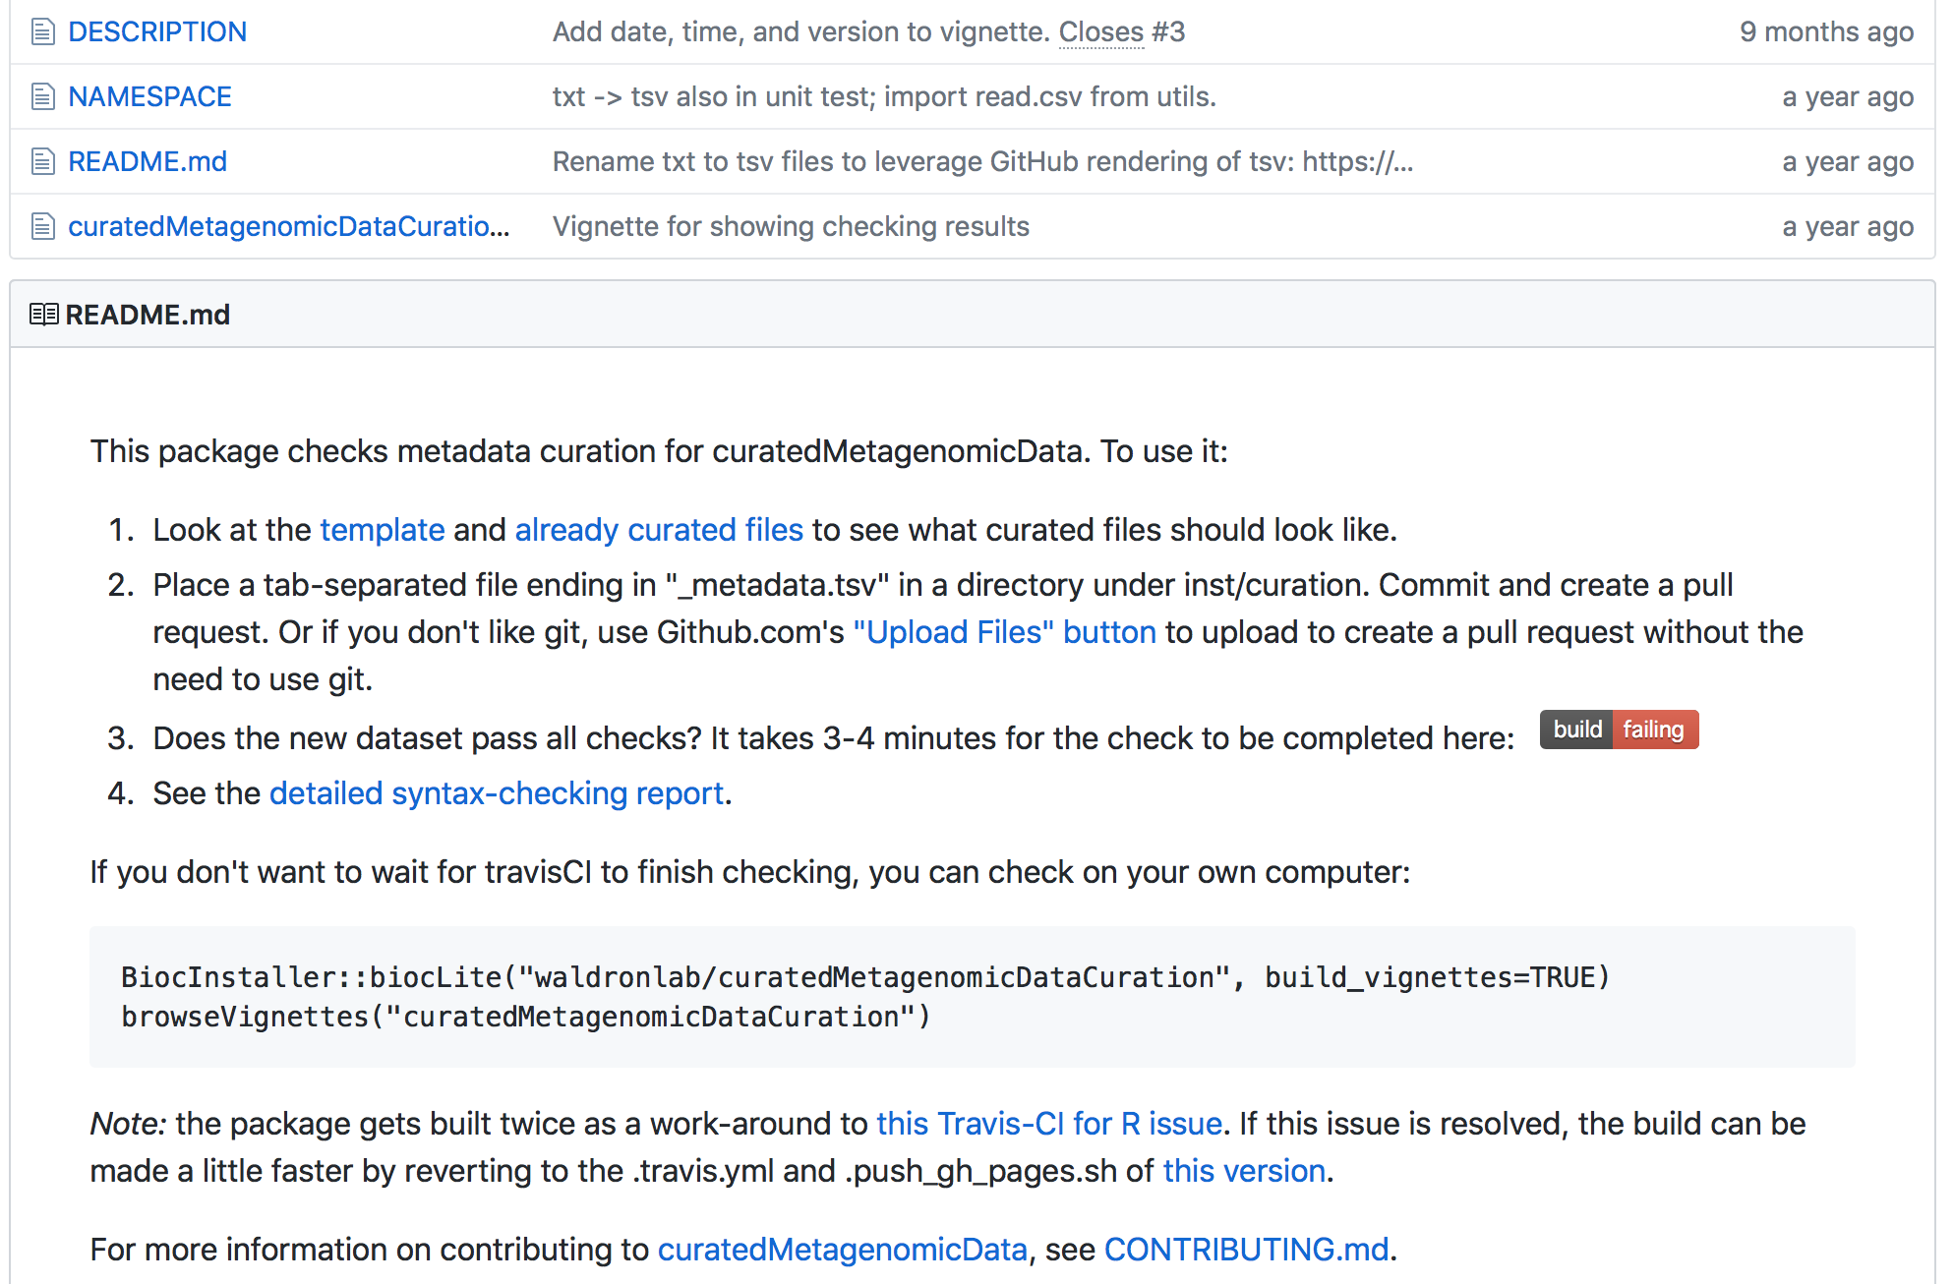
Formalizing curation
Pasolli E et al.: Accessible, curated metagenomic data through ExperimentHub. Nat. Methods 2017, 14:1023–1024.

Slide 48

Thank you
waldronlab.io
Post-docs: Ludwig Geistlinger, Sehyun Oh
Developer: Marcel Ramos
PhD student: Chloe Mirzayi
MPH students: Shaimaa Elsafoury, Fatima Zohra, Marianthi Thomatos, Phyu Han
Research interns: Rimsha Azhar, Christina Brown
Collaborators:
Giovanni Parmigiani and Lorenzo Trippa (DFCI)
Michael Birrer (UA Comprehensive Cancer Center)
Nicola Segata (UNITN)
Bioconductor: Martin Morgan, Vincent Carey, Kasper Hansen
Notes:
met Jin Xu from East China Normal University, Shanghai

Slide 49
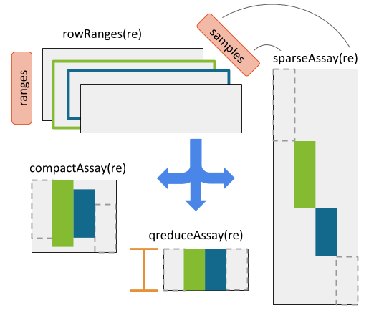
RaggedExperiment (segmented copy number, mutations)
Credit:
Marcel Ramos
Martin Morgan
http://bioconductor.org/packages/RaggedExperiment

Slide 50
Cross-study validation specialist and generalist algorithms
What constitutes a good learning algorithm?
A “specialist” that performs well when trained and applied to a single population and experimental setting?
A “generalist” that is sub-optimal for the training population, but performs reasonably well across different populations and experimental setting ?

Slide 51
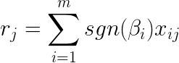
Ma ́s-o-menos: in search of a “generalist” algorithm
Perform univariate regressions
Generate a risk score from coefficient signs:
Formalized an old idea, evaluated theoretically, in simulations
bladder, breast, and ovarian cancers
27 independent microarray studies, 3,833 patients with survival outcomes.
Zhao, S. D. et al. Más-o-menos: A simple sign averaging method for discrimination in genomic data analysis. Bioinformatics 30, 3062–3069 (2014).
Notes:
r_j=\sum_{i=1}^{m}sgn(\beta_i)x_{ij}

Slide 52
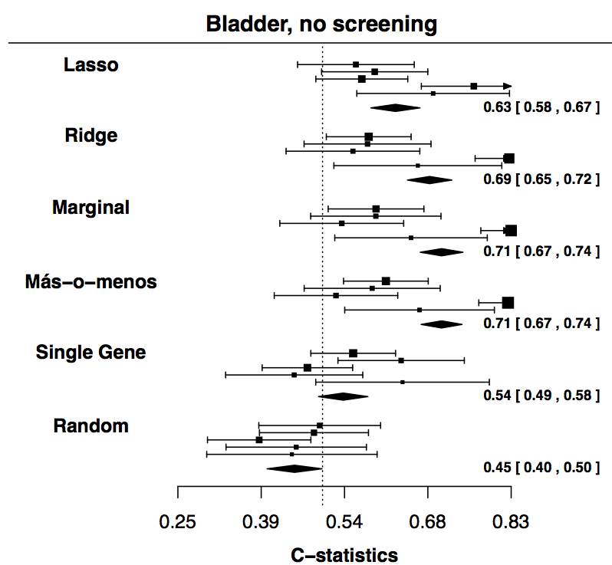
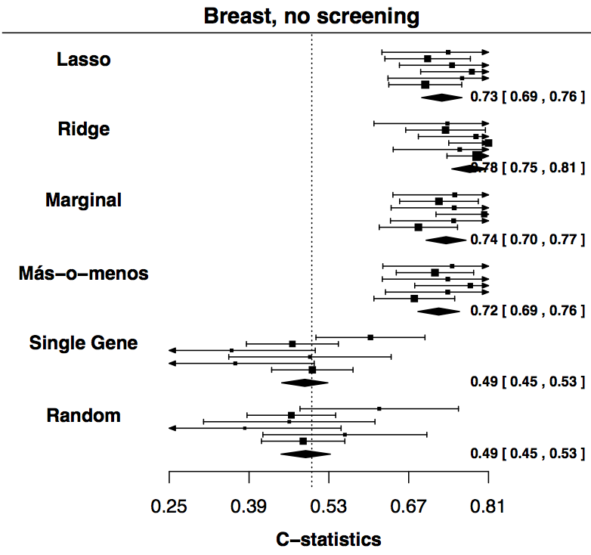
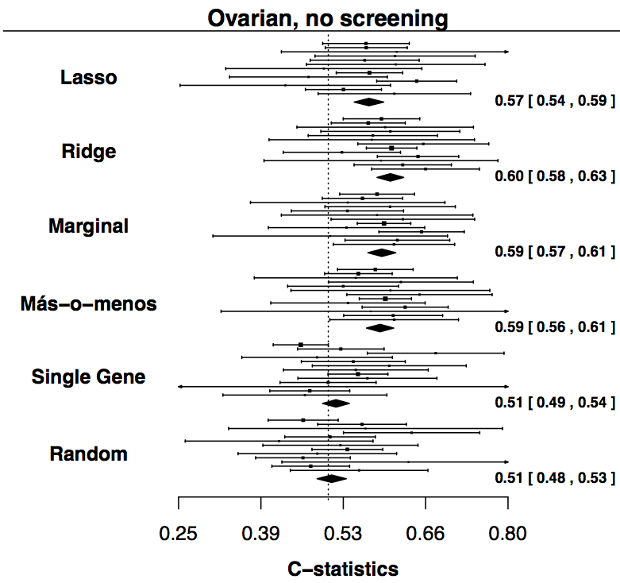
Ma ́s-o-menos: in search of a “generalist” algorithm
Zhao, S. D. et al. Más-o-menos: A simple sign averaging method for discrimination in genomic data analysis. Bioinformatics 30, 3062–3069 (2014).
Notes:
r_j=\sum_{i=1}^{m}sgn(\beta_i)x_{ij}

Slide 53
Potential future work
Increase the amount of usable data
Account for the residual CV/CSV gap
Extension of .632 for two-step fully non-parametric bootstrap
Other validation metrics (PPV/NPV)

Slide 54
A reproducible, replicable classifier for high-grade serous ovarian carcinoma
Based on consensus of three published subtyping efforts of HGSOC
Originally defined to classify every tumor – poor robustness and concordance
Modified to predict probabilities of each subtype, and allow leaving ambiguous tumors unclassified
16 datasets from curatedMetagenomicData
Chen et al: Consensus on Molecular Subtypes of High-grade Serous Ovarian Carcinoma. Clin. Cancer Res. 2018:clincanres.0784.2018.

Slide 55
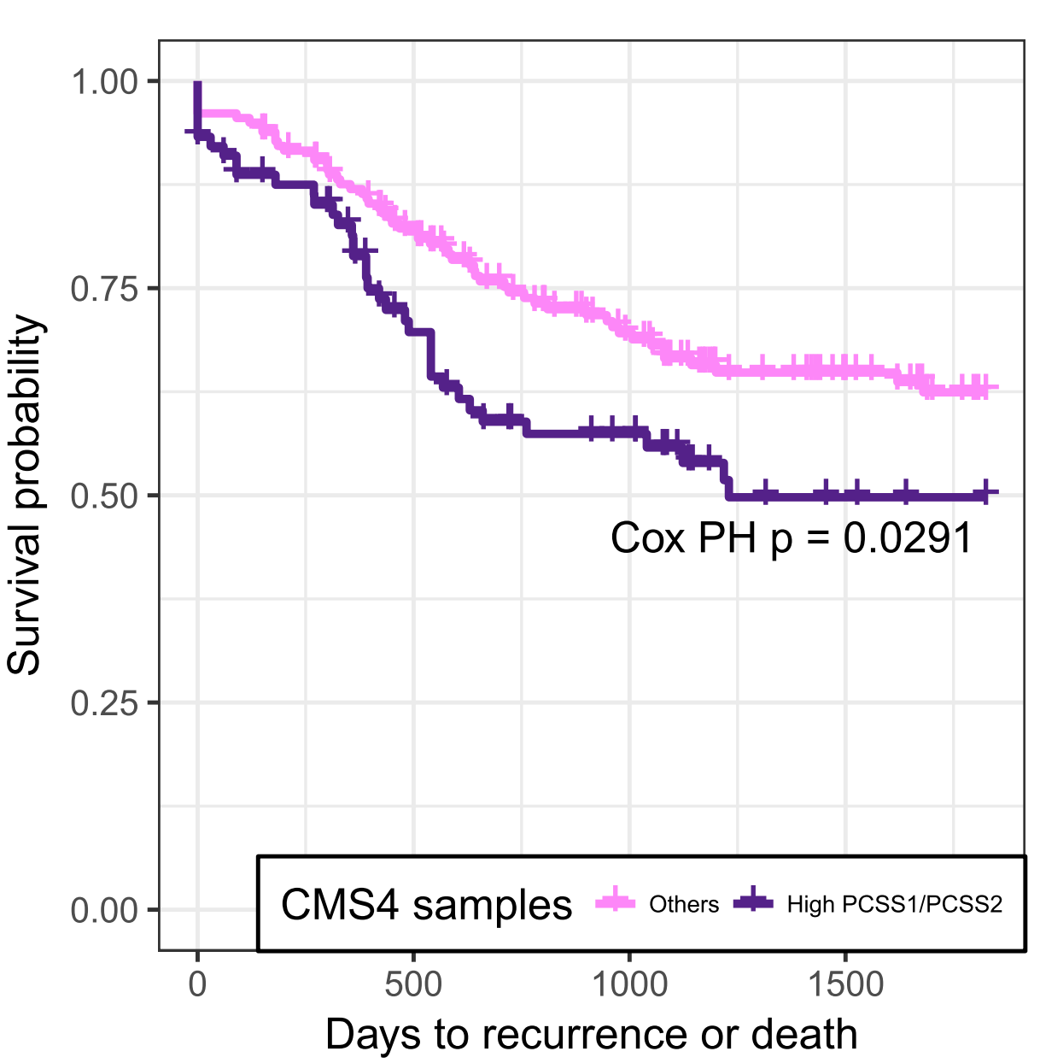
PCSS further differentiate CMS subtypes

